Slide 1

Coca-Cola (KO) Stock Performance Analysis

Slide 2
Project Objectives & Scope
Section | Content
Context | Analysis of a major blue-chip stock (KO) to demonstrate proficiency in data processing, technical indicator calculation, and financial visualization using Python.
Primary Goal | Perform Exploratory Data Analysis (EDA) on KO's historical data to identify long-term trends, market stability, and volatility patterns.
Key Objectives | 1. Data Engineering: Load, clean, and re-index historical time series data. 2. Feature Creation: Calculate and analyze key technical indicators (50-Day & 200-Day Simple Moving Averages). 3. Visualization: Produce professional plots for price, volume, and SMA crossovers. 4. Actionable Insights: Conclude with data-driven recommendations for investors.

Slide 3
Methodology, Tools, & Key Code
Section | Content
Data Sources | Historical Data: Coca-Cola_stock_history.csv (Daily prices since 1962). Fundamental Info: Coca-Cola_stock_info.csv (Sector, Financial Metrics).
Tools & Libraries | Primary: Python (Pandas for data processing, Matplotlib/Seaborn for visualization).
Key Steps | 1. pd.to_datetime and set_index on 'Date' column. 2. df['SMA_50'] = df['Close'].rolling(window=50).mean(). 3. Plotting of all three series on a single chart for visual trend confirmation.
Technical Indicator | Simple Moving Average (SMA): Confirms trend direction (200-Day for long-term support, 50-Day for medium-term momentum).

Slide 4
Company Profile & Fundamental Data
Section | Content
Ticker/Name | KO / The Coca-Cola Company
Sector / Industry | Consumer Defensive / Beverages—Non-Alcoholic
Business Summary | Global beverage giant known for carbonated soft drinks, water, juice, and tea. Operates via a vast global network of bottling partners. (Based on longBusinessSummary field).
Key Financial Metrics (from CSV) | Forward P/E Ratio: ~24.5x (Relatively high, indicating market confidence in future earnings). Beta: ~0.71 (Indicates Low Volatility; a defensive stock). Profit Margins: ~23.3% (Strong profitability characteristic of a market leader).

Slide 5
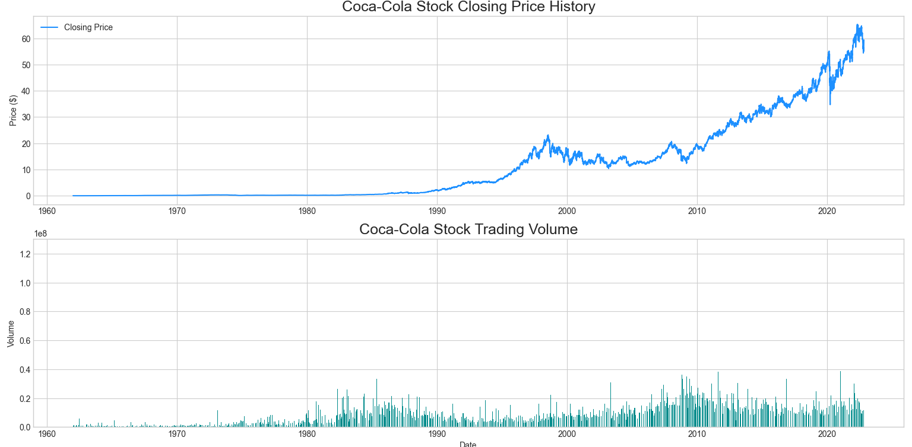

Slide 6
Technical Analysis - Moving Averages (50-Day & 200-Day)
Element | Content
Title | Trend Confirmation: 50-Day and 200-Day SMAs
Visualization | Plot of Close Price, 50-Day SMA, and 200-Day SMA.
50-Day SMA | Tracks medium-term price momentum. Used to identify potential short-term reversals.
200-Day SMA | Confirms the long-term trend. The price consistently trading above the 200-Day SMA is the strongest bullish signal derived from the analysis.
Crossover Insight | Price dips toward the 200-Day line typically act as strong support levels, reinforcing the stock's stability and making these points of interest for long-term buying.

Slide 7
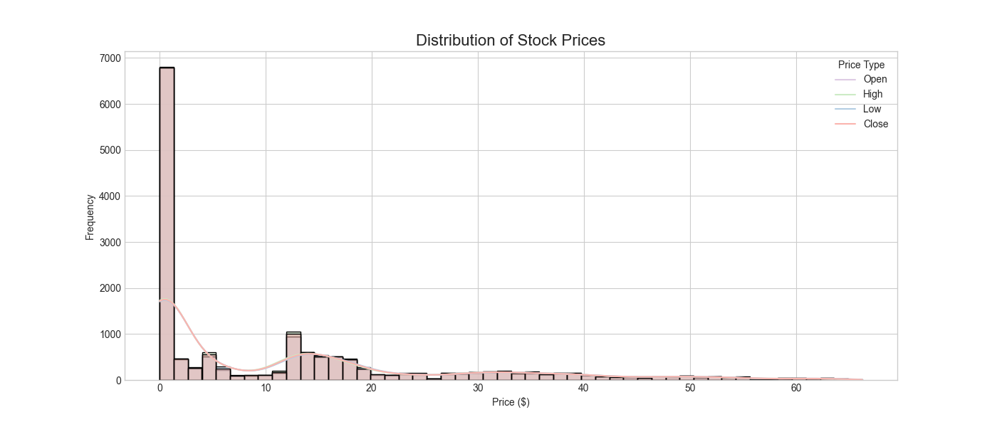

Slide 8
Trading Volume & Volatility
Element | Content
Title | Trading Volume Activity & Liquidity
Visualization | Plot of Volume over time.
Observation | Volume exhibits an overall upward trend, with notable significant spikes in recent years.
Key Insights | 1. Liquidity: The high volume confirms the stock is highly liquid, making large trades easy to execute. 2. Event Correlation: Volume spikes often coincide with major events like earnings reports, dividend adjustments, or significant news, highlighting periods of strong institutional interest.

Slide 9
Summary of Key Analytical Findings
Finding | Metric/Observation | Interpretation
Market Resilience | Beta: ~0.71 (Low Volatility) | The stock is less sensitive to systematic market risk; an excellent hedge during broad market instability.
Dominant Trend | Price consistently > 200-Day SMA | Confirms dominant, enduring upward momentum, justifying a long-term bullish outlook.
Profitability | Profit Margin: ~23.3% | Indicates strong pricing power and highly efficient operations characteristic of a blue-chip stock.
Technical Support | 200-Day SMA tested as a reliable support level. | Provides a clear technical indicator for defining low-risk investment entry points.

Slide 10
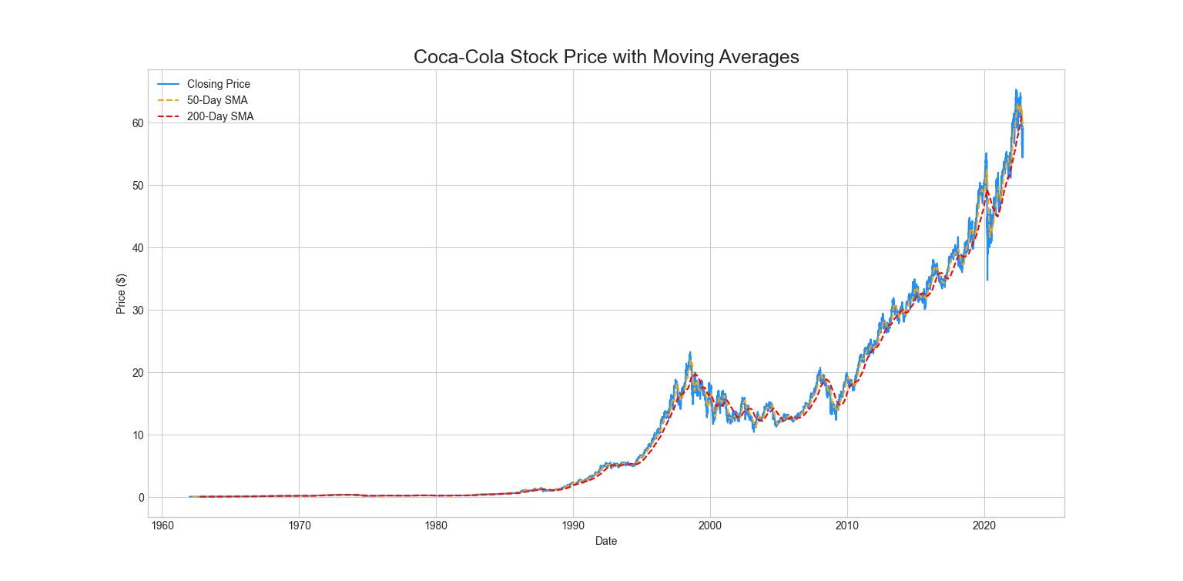

Slide 11
Conclusion & Investor Recommendations
Section | Content
Conclusion | The Coca-Cola Company (KO) is a foundational, highly profitable, and defensive blue-chip stock whose long-term growth is strongly confirmed by technical and fundamental indicators.
Recommendation 1 | Long-Term Hold: Recommended for conservative investors seeking consistent returns and reliable dividend income with low volatility.
Recommendation 2 | Strategic Entry Point: Use the 200-Day SMA as a technical reference point. Any price approaching this line represents a strategic, value-driven buying opportunity.
Future Work | Incorporate Machine Learning (ML) techniques to predict short-term price movement by adding advanced indicators (RSI, MACD, Bollinger Bands) for automated signal generation.

